Slide 1
AVR Interfacing IO Ports

Slide 2
Agenda
I/O Ports.
I/O Ports Programming.
Interfacing with Switches and Leds.
Interfacing with 7-Segment.
Interfacing with DC-Motor.
Interfacing with LCD.
Interfacing with Keypad.

Slide 3
I/O Ports
ATmega328p has programmable I/O lines divided into:
ADC 7:6
PORTB(PB7….…..PB0)
PORTC(PC6….…..PC0)
PORTD(PD7……..PD0)
Each PORT is controlled by 3 registers:
DDRx :
Data Direction Register to set the pin either output or input pin.
PORTx
Output Register to assign a value to the port (from µC to interface).
PINx:
Input Register where it holds the input value from interface.
Note: Most pins in µC make more than one function (multiplexed functions)

Slide 4
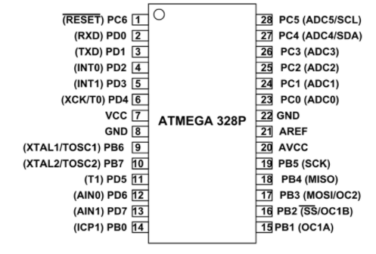
I/O Ports

Slide 5
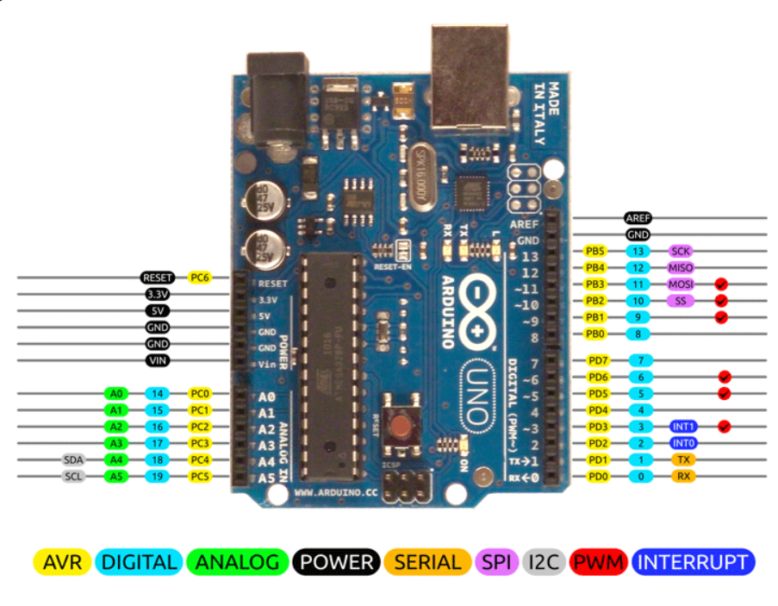
I/O Ports

Slide 6
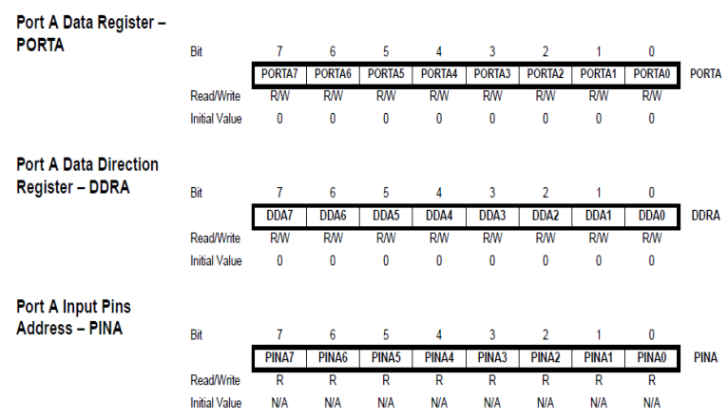
I/O Ports

Slide 7
I/O Ports Programming
To decided which Port is input and which is output:
Configure the port direction use register DDRX 1 🡪 for Output. 0 🡪 for Input.
To Read(input case) :
Use register PINx
To Write(output case) :
Use register PORTx.
Note:
In case you set any PIN as input you can activate the internal pull up resistor by setting the corresponding bit in PORTX register.

Slide 8
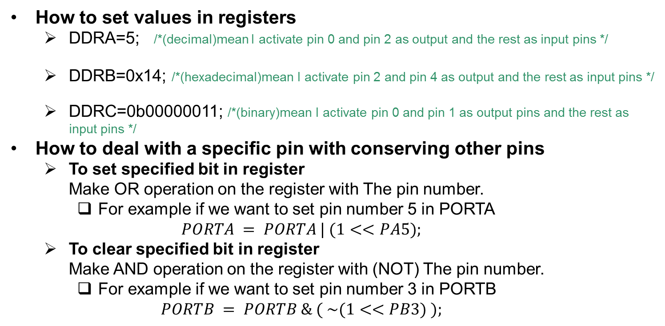
I/O Ports Programming

Slide 9
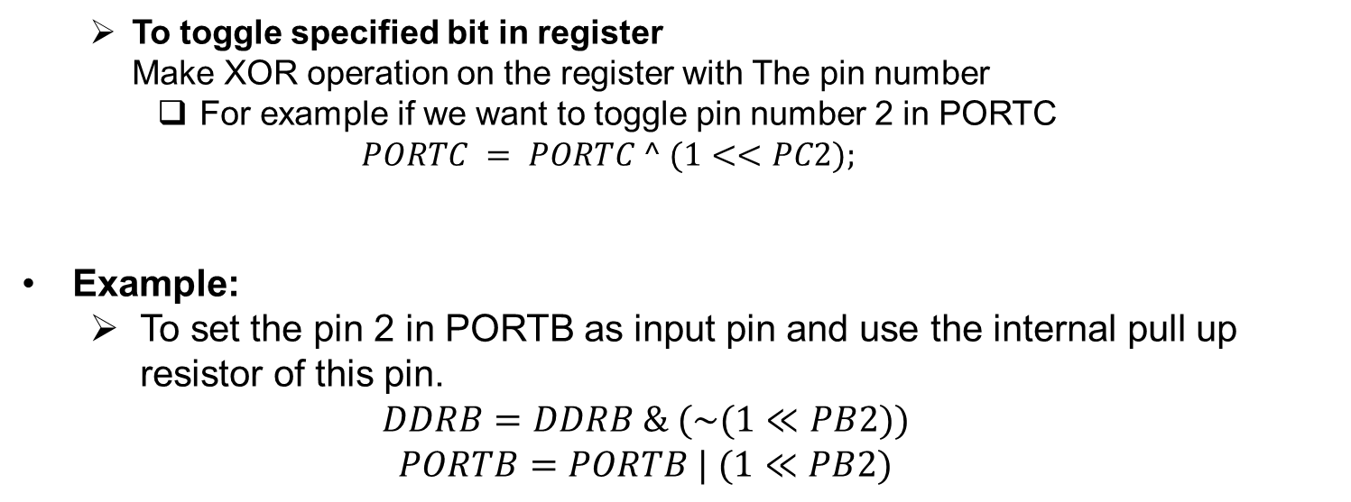
I/O Ports Programming

Slide 10
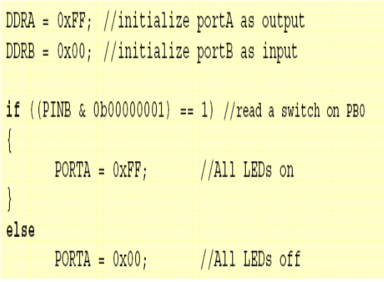
I/O Ports Programming

Slide 11
I/O Ports Programming
I/O Port applications I/O Port applications
As Output • LED and 7-Segemnt • LCD display • Motors. • Buzzer. • Signal to another µC. • Output to PC through PC Serial Port.
As Input • Switches(push button, keypad etc.) • Analog/Digital sensors. • Signal from another µC. • Input from PC through PC Serial Port.

Slide 12
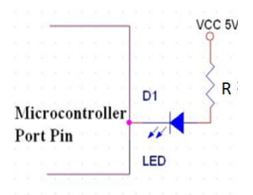
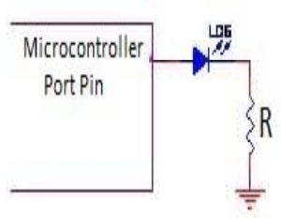
Interfacing with Switches and Leds
I/O Port applications LED Configuration
Negative Logic
Positive Logic

Slide 13
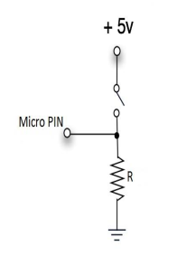
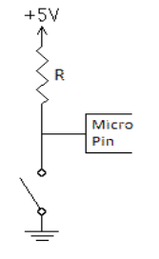
Interfacing with Switches and Leds
I/O Port applications Switch Configuration
Pull Down Resistor
Pull UP Resistor

Slide 14
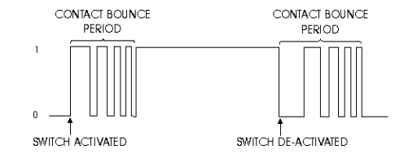
Interfacing with Switches and Leds
I/O Port applications Switch de-bounce problem
Could be handled using software or hardware.
It relies on the fact that bouncing takes a maximum period of 20-30 ms.
The basic idea is to implement a delay after the first detected edge, during which no scanning for the switch is done. after the delay period is finished, scanning can proceed (Exercise 3).

Slide 15
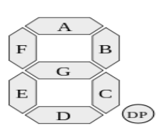
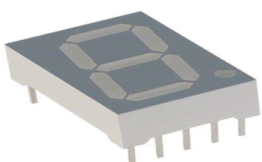
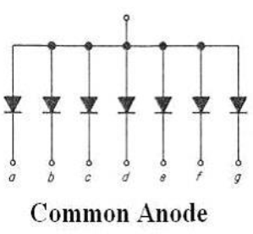
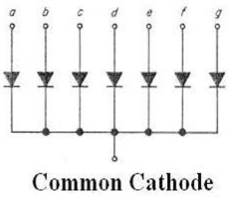
Interfacing with 7-Segment

Slide 16
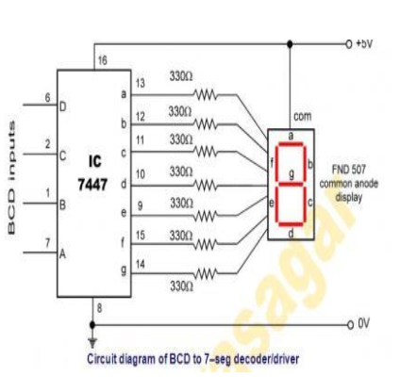
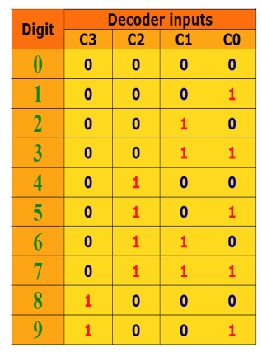
Interfacing with 7-Segment
In order to reduce the number of pins can be used to interface the 7 segment,
we use decoder connected and follows;

